Slide 1
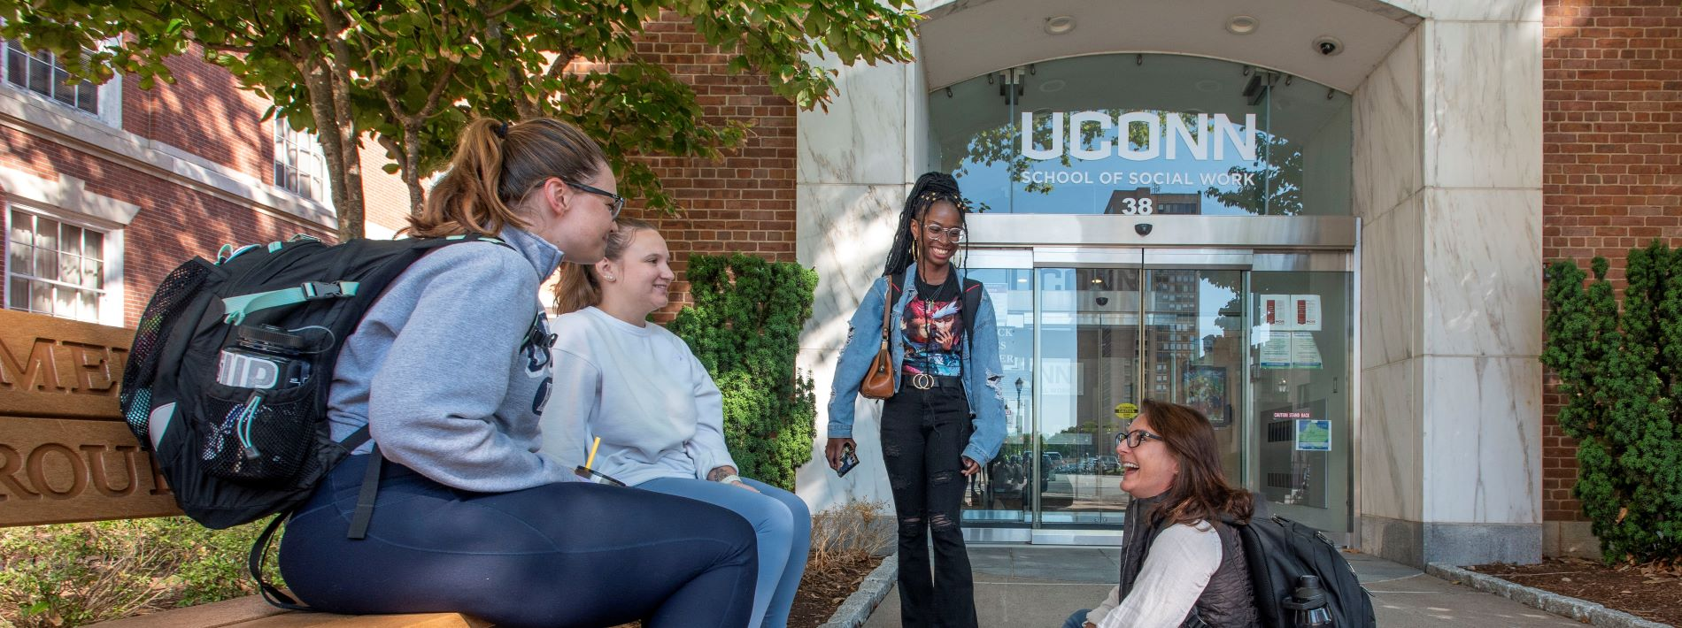
Spring 2024
UConn School of Social Work
Orientation and Welcome for
New Adjunct Instructors

Slide 2
Agenda
Welcome & Introductions
UConn SSW’s Commitment to Reflective and Engaged Teaching
General Information – UConn IDs, First Paycheck, Helpful Websites for SSW Adjuncts
Campus Information
MSW & BSW Programs – Overview
Role of Faculty Advisor
Campus Information
Student Admin & HuskyCT

Slide 3
Welcome!
Introductions –
Joy Learman– Interim MSW Program Director
Paula Nieman – BSW Program Director
Milagros Marrero-Johnson – Director of Strategic Programming
Chelsea Lebron – Educational Program Assistant

Slide 4
UConn SSW’s Commitment to Reflective and Engaged Teaching
Social work education in the context of COVID recovery efforts means renewing connections to students, communities we come from and serve, and to critical social action and care work.
Social work schools are always “catching up” to rapidly changing contexts and needs. We want the SSW to be a place where practitioners, researchers, policy makers, and students come into regular contact and work to hear each other and learn together.
Critically important as social work educators that we seek and find support to continue to grow in the art of teaching in social work.

Slide 5
UConn SSW’s Commitment to Reflective and Engaged Teaching
If and whenever you can, please join the Pedagogy Workshop – here is the schedule: https://socialwork.uconn.edu/wp-content/uploads/sites/3705/2023/07/Pedagogy-Workshops-and-Check-Ins-for-2023-2024.pdf
Facing a challenging discussion in class or feel stuck? For support and consultation, please reach out to the relevant Program Director. Additional potential sources of support and guidance may include Milagros Marrero-Johnson and your teaching group.
Phare share ideas for workshop topics and feedback to help us build on this initiative.
Please join us for events at the SSW and talk to students about them.

Slide 6
Getting Set up: Campus Information
Mailboxes – 1st floor of SSW in Room 103 – Entry Code 2018
Adjunct Office – Room 217
Parking
CT Science Center (permit), Convention Center (permit), or Street Parking (metered)
Hartford Times Building (10 Prospect)
UConn Library at Hartford Public Library
ID (Husky One Card) – HTB Room 106 (Student Services)
959-200-3743
Mon – Fri: 8:30am – 4:30pm or by appointment
Request online & have it mailed to you

Slide 7
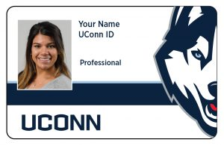
Getting Set Up: Technology/ Systems
NetID vs. PeopleSoft
Your NetID is the primary login for university services, including library access, HuskyCT access, and email access. Your NetID can be found at: https://netid.uconn.edu/ and must be activated with a new password for use.
UConn PeopleSoft ID: Your UConn ID number (often called your PeopleSoft number) is a seven-digit number specifically assigned to you. This number is used in the Student Admin system: https://studentadmin.uconn.edu/ and can be found on your UConn ID card.
Please use your UConn email address and check it regularly. Your UConn email can be accessed here: https://email.uconn.edu/

Slide 8
Key Offices and Resources
Adjunct Faculty Webpage: https://socialwork.uconn.edu/info-faculty-staff/
Office of Student Academic Services (OSAS): https://socialwork.uconn.edu/current-students/
UConn Hartford ITS: https://hits.hartford.uconn.edu/ (located in the School of Social Work Building, Lower Level | Room G02)
Field Education – BSW & MSW information

Slide 9
First Paycheck and Direct Deposit
Paychecks are issued bi-weekly
Your paychecks will be mailed to you until you set up direct deposit
Direct deposit is available in https://ess.uconn.edu/ (Core-CT) after your start date
Link to 2023 Payroll Calendar: https://payroll.uconn.edu/wp-content/uploads/sites/2008/2022/10/2023-Pay-Calendar.pdf

Slide 10
MSW & BSW Programs
Please review the following email attachments & links:
Resource Guide
New Hire Flyer
MSW & BSW Student Handbooks
https://socialwork.uconn.edu/msw-students/
https://socialwork.uconn.edu/bsw-students-2/
Syllabus – Boilerplate language
EPAS (Educational Policy and Accreditation Standards) from CSWE (Council on Social Work Education)
SET (Student Evaluations of Teaching)

Slide 11
MSW & BSW Programs Continued
EPAS (Educational Policy and Accreditation Standards) from CSWE (Council on Social Work Education)
If you are teaching a non-elective course, you are required to complete an EPAS sheet at the end of the semester. Instructions will be provided – please monitor your UConn email address throughout the semester. These sheets will be sent out by Chelsea Lebron a week or so before final grades are due.

Slide 12
Role of Faculty Advisors
Two Roles: Both Academic and Field
Every matriculated student (both in field and not in field) is assigned an advisor at the beginning of the school year
Oversees the student’s academic and field performance for the year
Works with students and instructors and possibly administration when there are challenges or difficulties
Supports students in their professional development/career/graduate school decision-making

Slide 13
When should I contact the Faculty Advisor?
To find out who a student’s advisor is, contact Chelsea Lebron or the Program Director
Frequent Absence, Repeated lateness
Late Papers or frequent requests for extensions
Lack of communication (e.g., no response to emails) and/or other unprofessional behavior
Health or mental health concerns and/or disclosure of difficulty related to basic needs (housing, food, etc.)
Email the advisor early on when situation arises. If no response or if problems continue, email the appropriate Program Director
Educational/Performance Review Committee & Consultations and Reviews

Slide 14
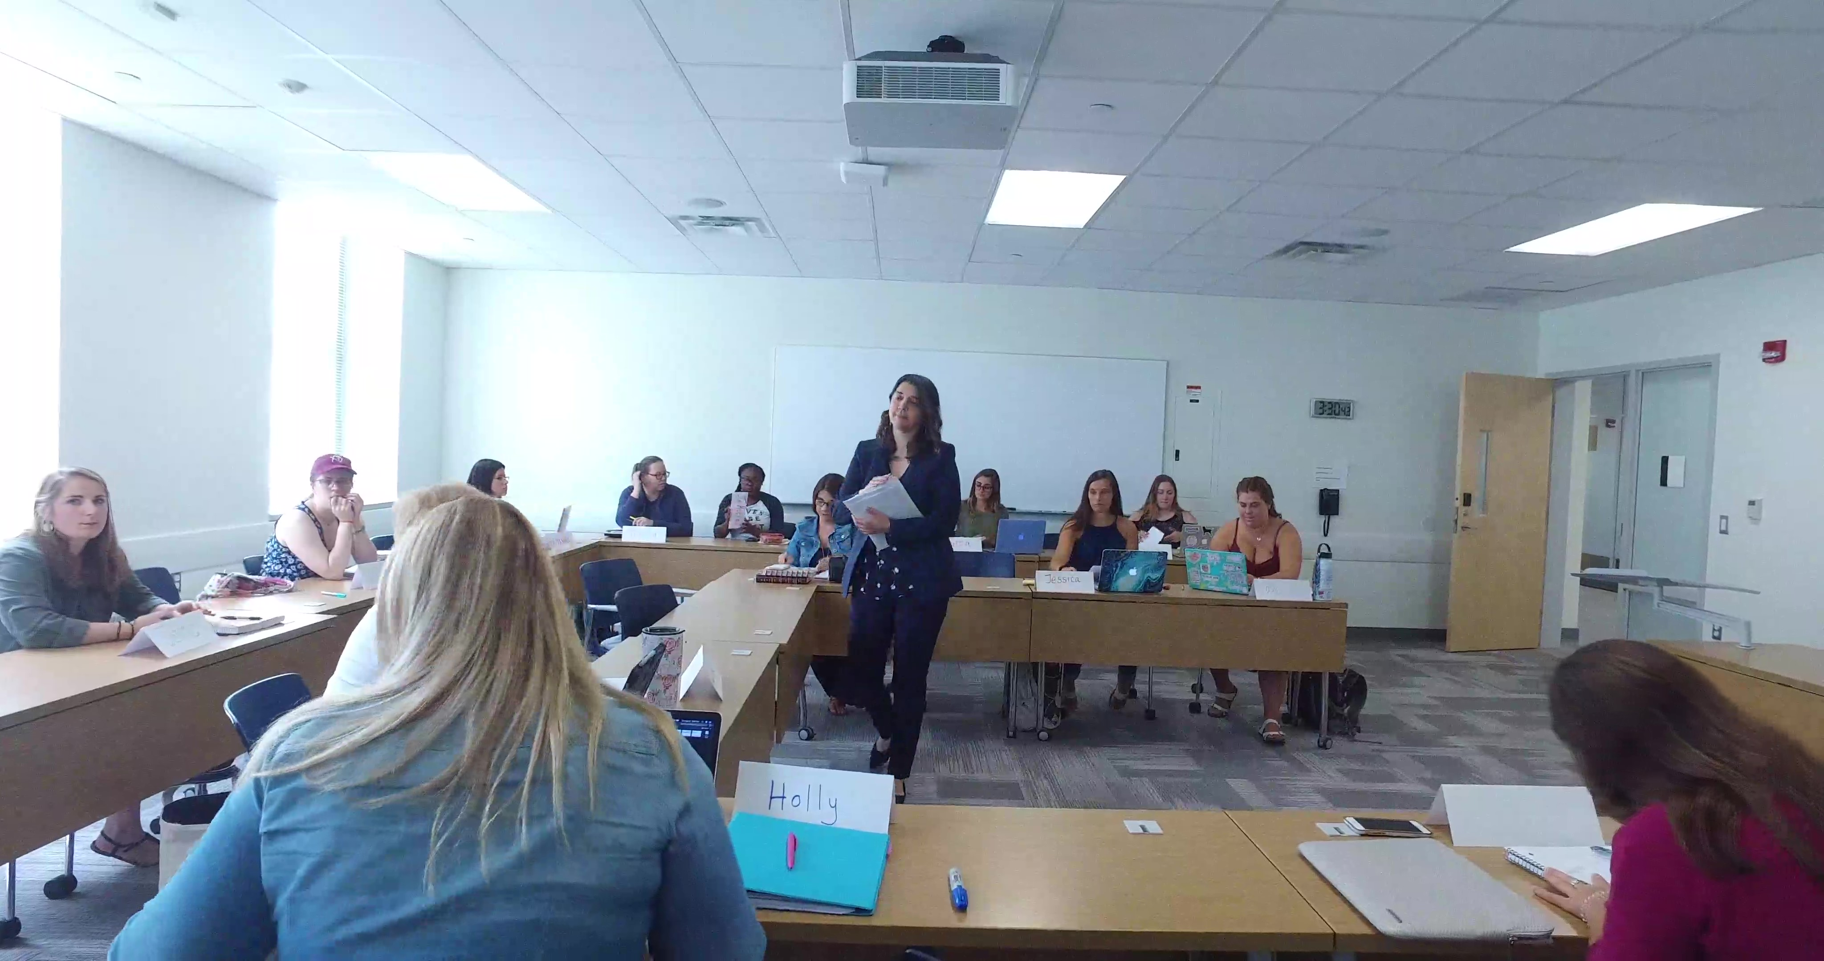
Brief Student ADMIN & HUSKYCT overview Milagros Marrero-Johnson, MSW

Slide 15
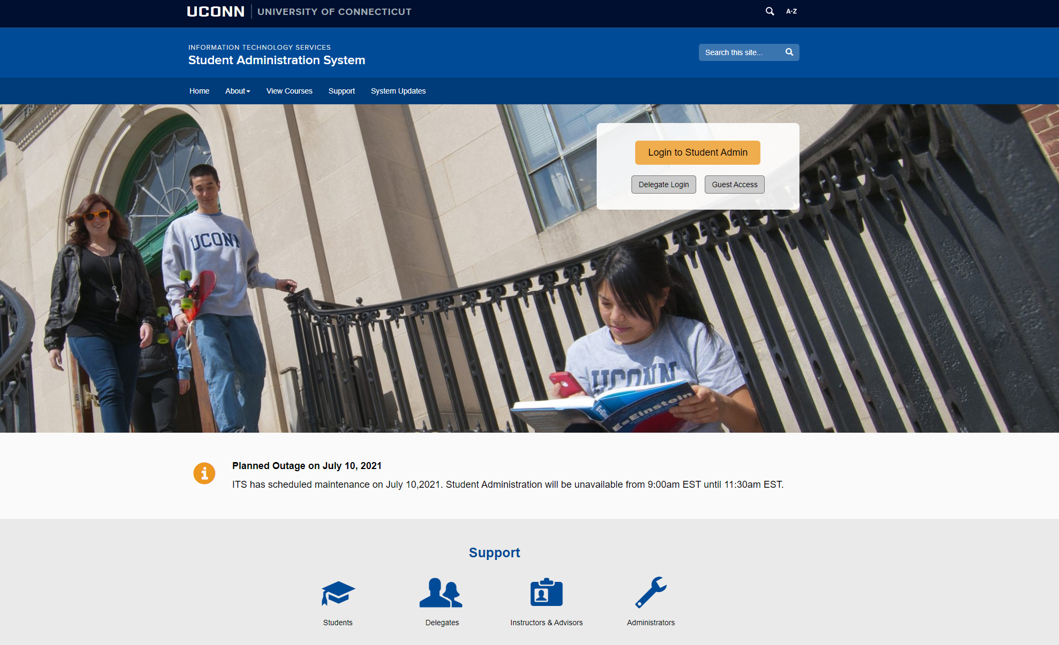
Student Administration System
The PeopleSoft Student Administration (Student Admin) system is a collection of interactive course and enrollment information and tools, which students will use starting with the admissions stage and continuing through graduation. A main feature of the system is the online registration tool, which enables students and their advisors to plan and enroll in classes.
Instructors and Advisors Support

Slide 16
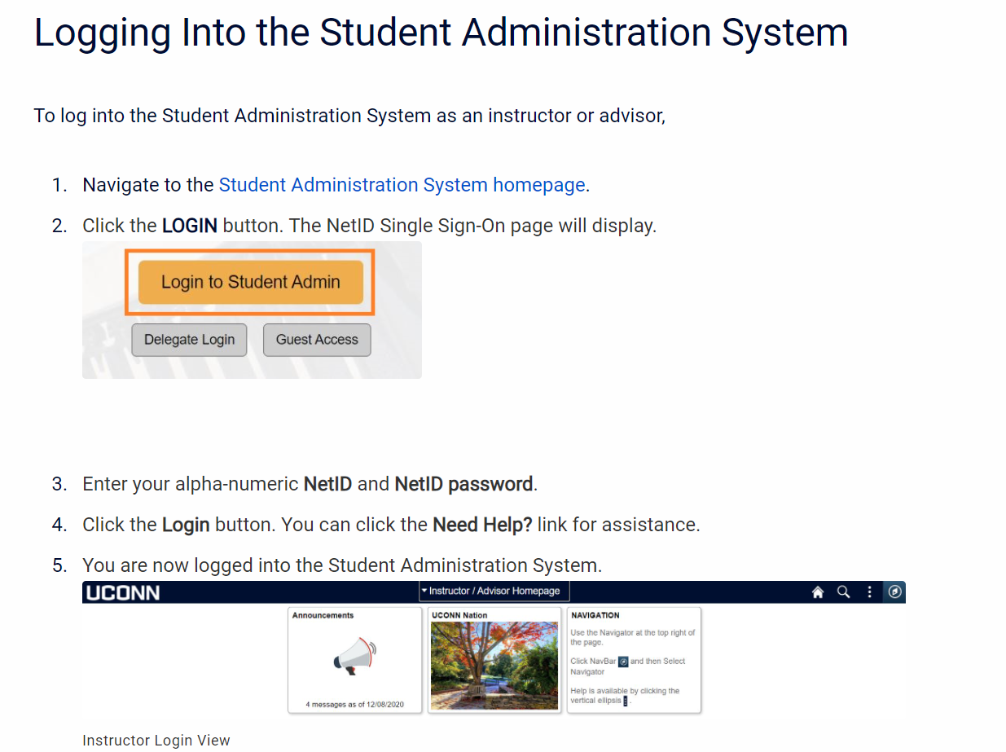
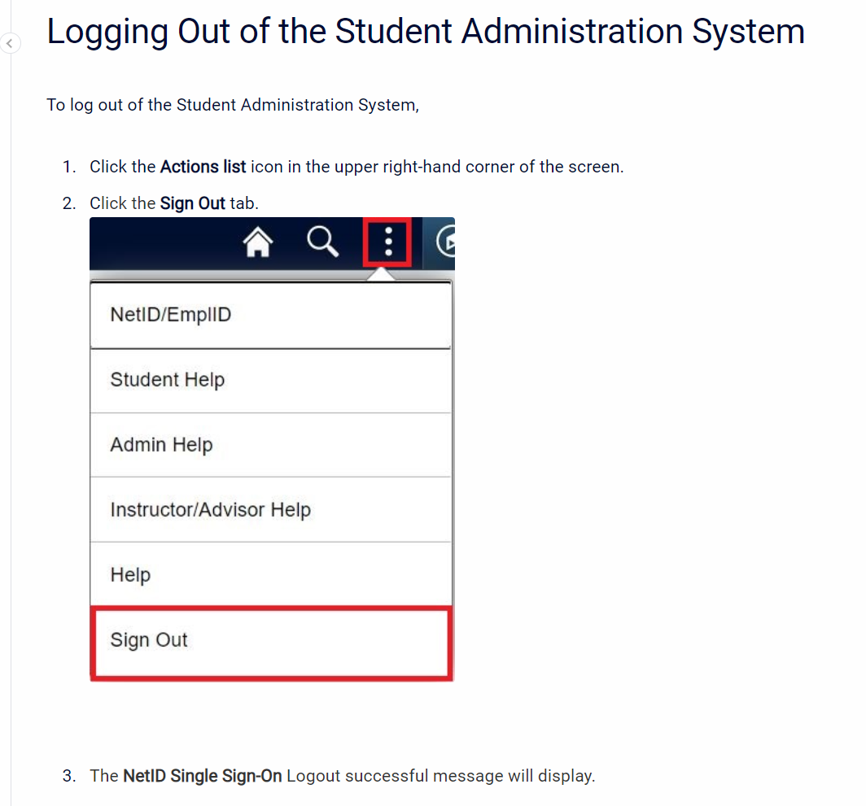
Logging into & out of student admin
Be sure to save to your favorites
Home | Student Administration System (uconn.edu)

Slide 17
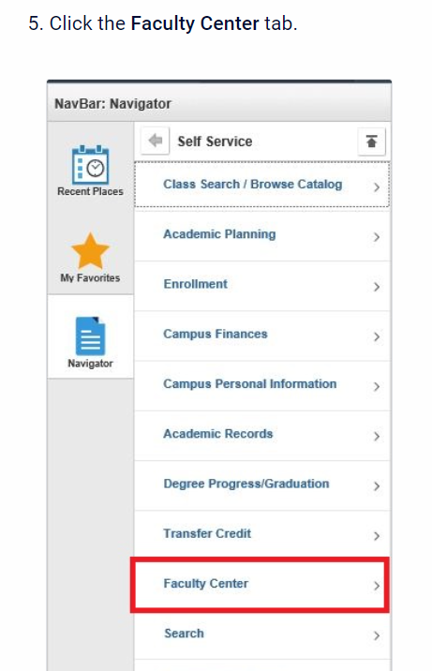
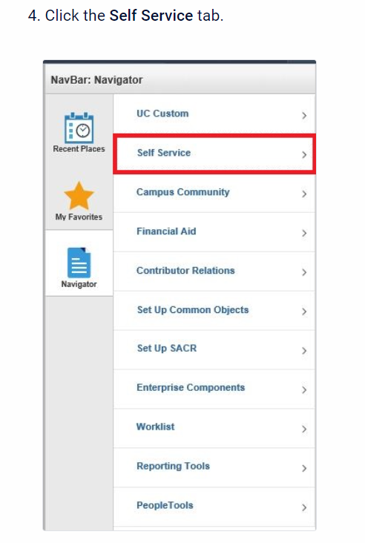
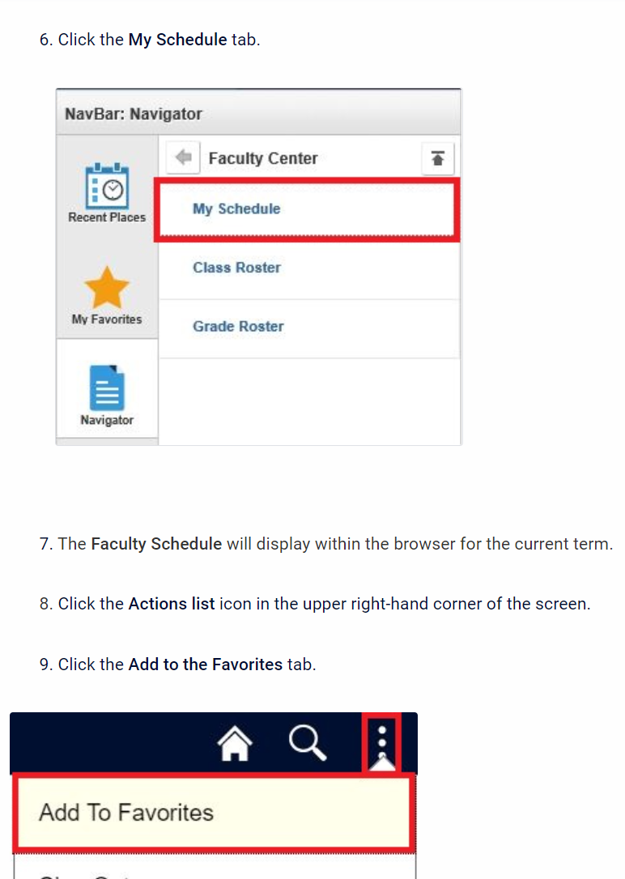
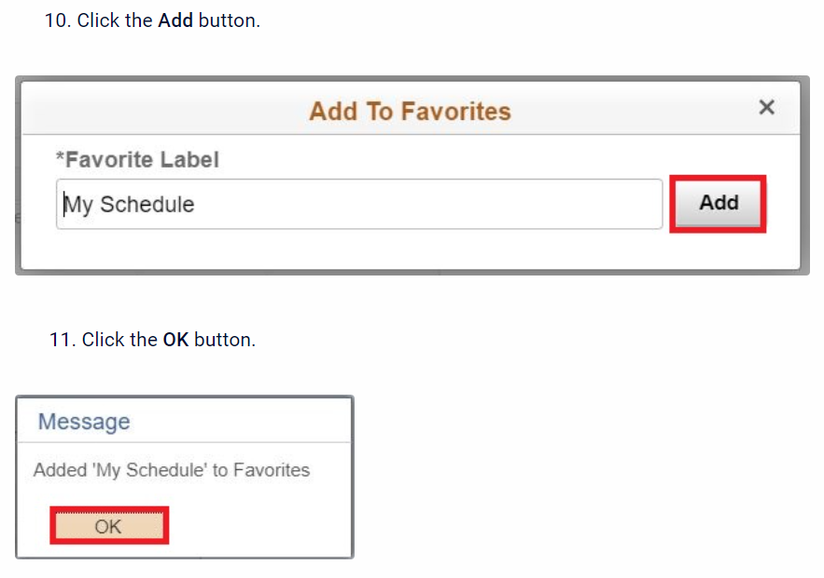
Setting common favorites – my schedule, class roster & Grade roster

Slide 18
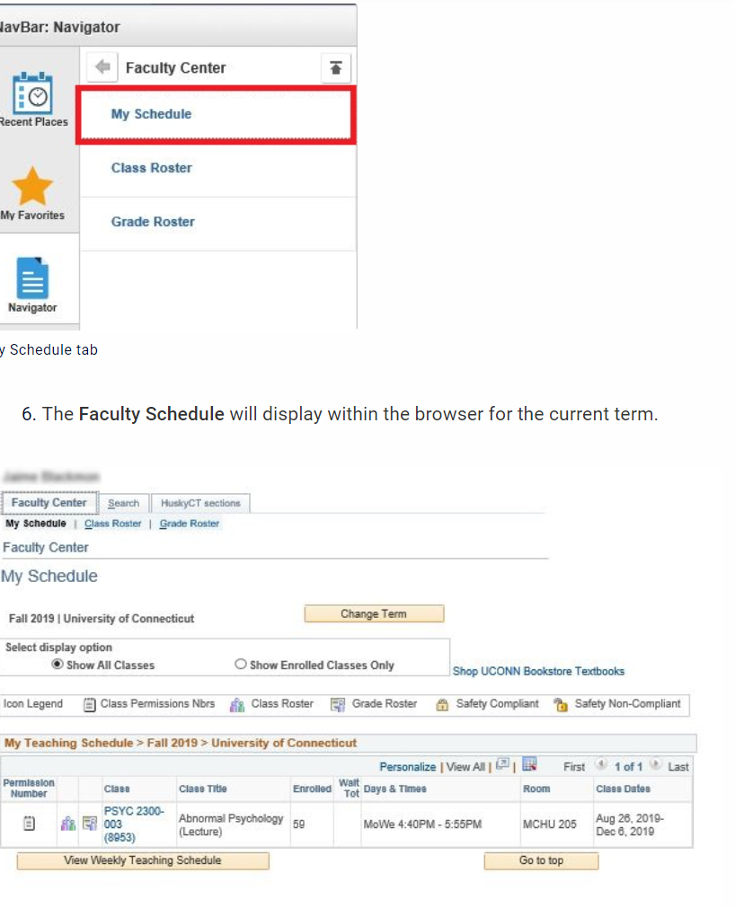
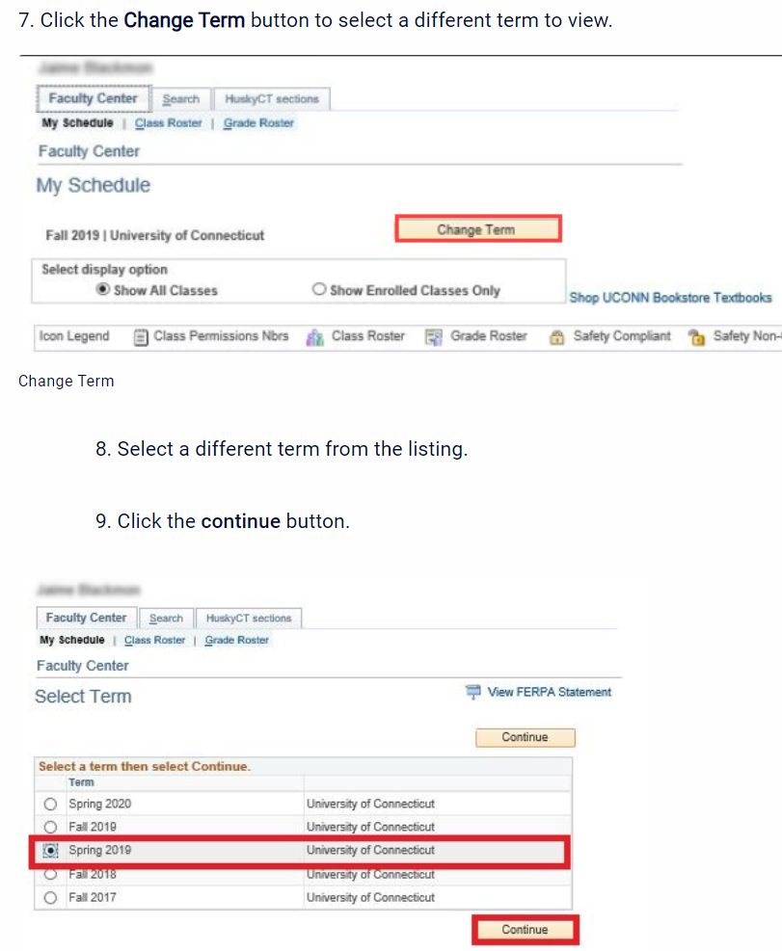
Viewing class schedule
Since you will have saved My schedule as a favorite, there will be less steps when you view your schedule.
Please note the highlighted indicates:
Permission number
class
title
# of students enrolled
days & times class meets
room number
semester dates

Slide 19
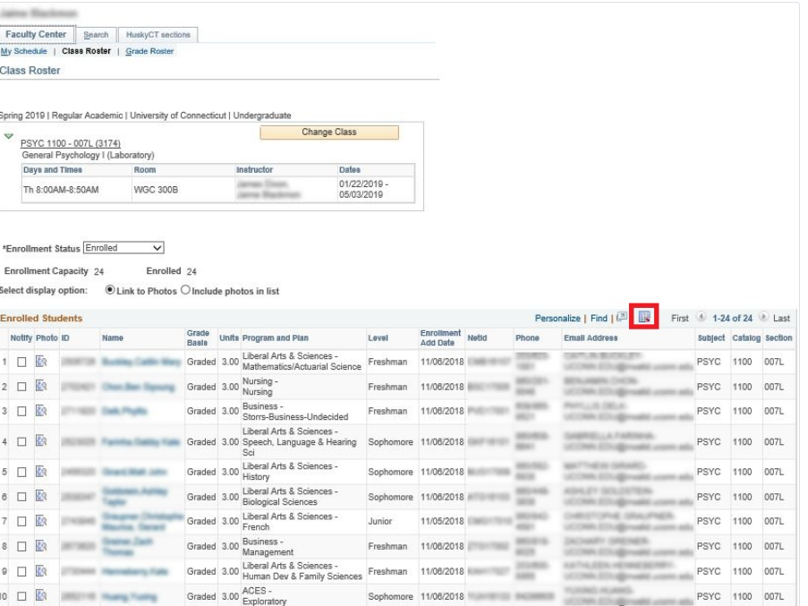
Downloading class roster
Log into Student Admin
Go to your Favorites bar and select Class roster
Ensure you are in the correct term
Click the grid icon located to the right of Find (see highlighted).
The roster will download as an Excel document in Chrome.

Slide 20
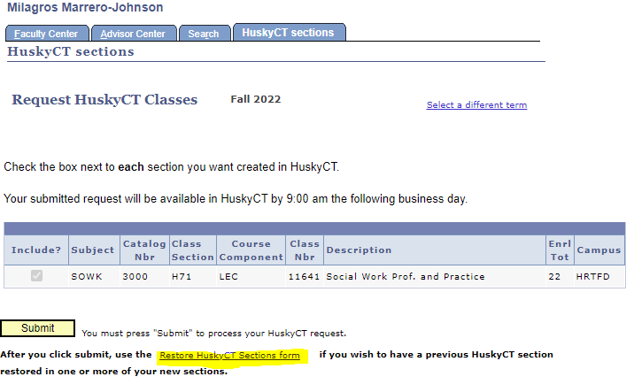
HuskyCT Course Request
Log into Student Admin
Go to My Schedule
Click on HuskyCT sections (top right tab)
Click on course
Hit submit
You will be notified by email when your HuskyCT site is available (usually one business day)

Slide 21
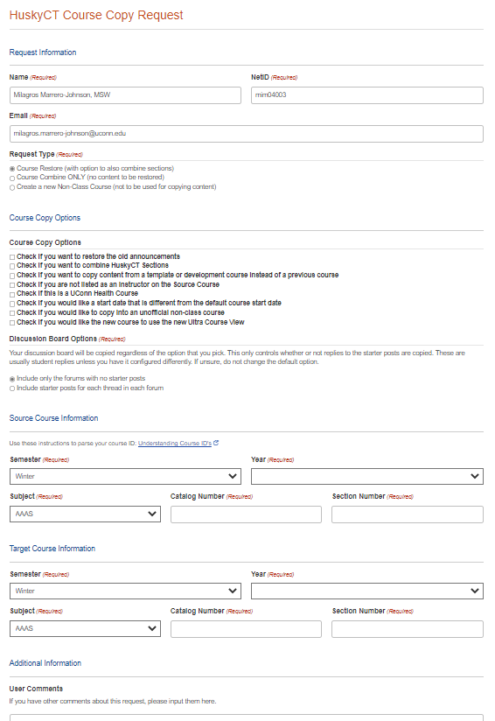
Restore HuskyCT sections form
You will then see this form when you click on Restore HuskyCT Sections
Please complete the form thoroughly
You will need the source course information if you will request copy content from a template or development course
Hit submit at bottom of the form

Slide 22
HuskyCT is UConn’s name for the Blackboard learning management system used. HuskyCT sites are used for face-to-face classes and fully online classes.
The use of HuskyCT is so widespread that students expect to see a HuskyCT site for each class they are taking and are worried when they don’t.
Most common uses of HuskyCT:
send announcements
post content and
post grades
Instructors also use HuskyCT for
online submission of assignments, discussions, and quizzes.
Blackboard Learn (uconn.edu)

Slide 23
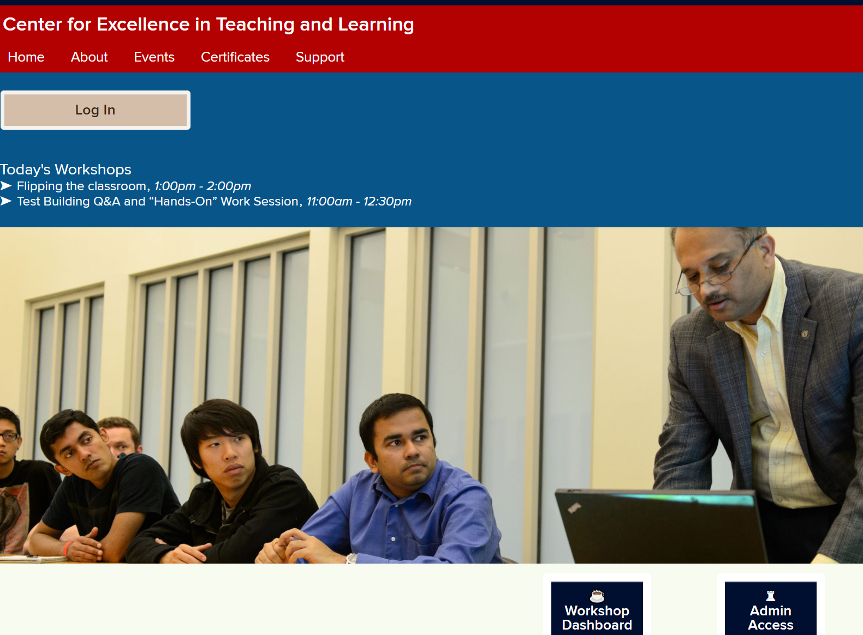
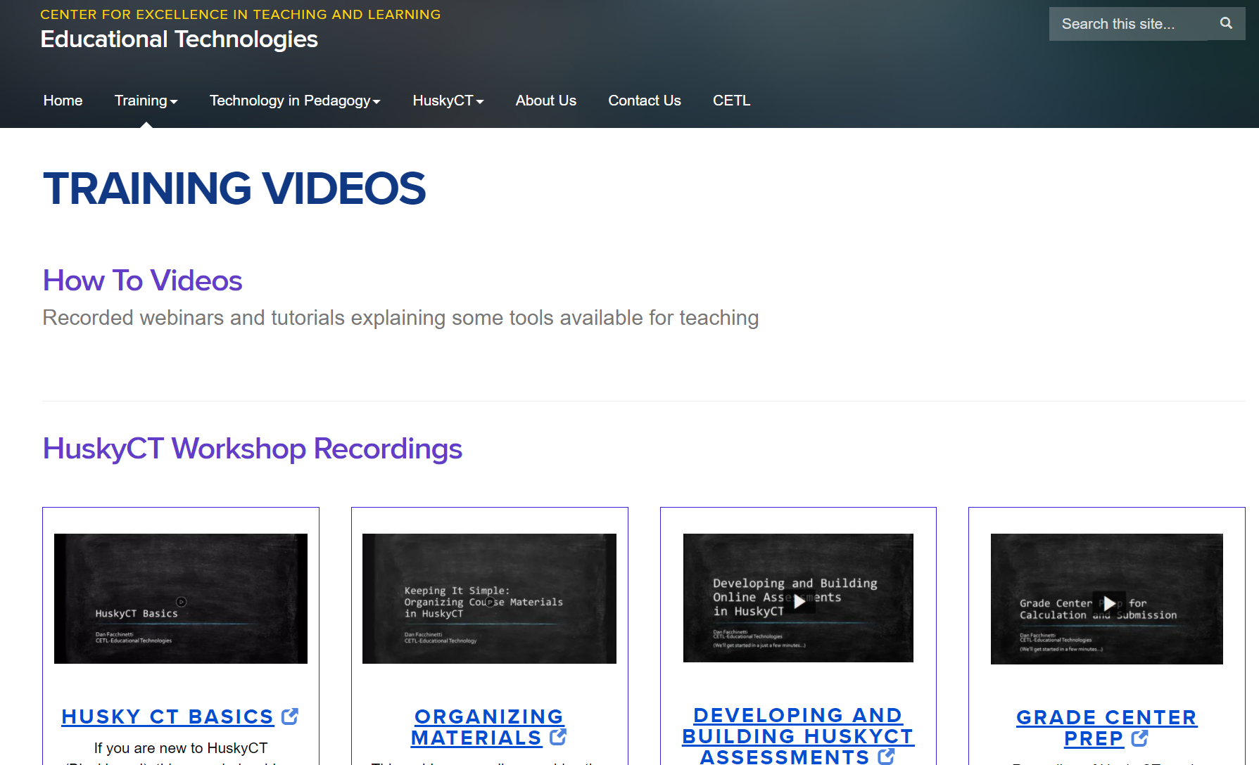
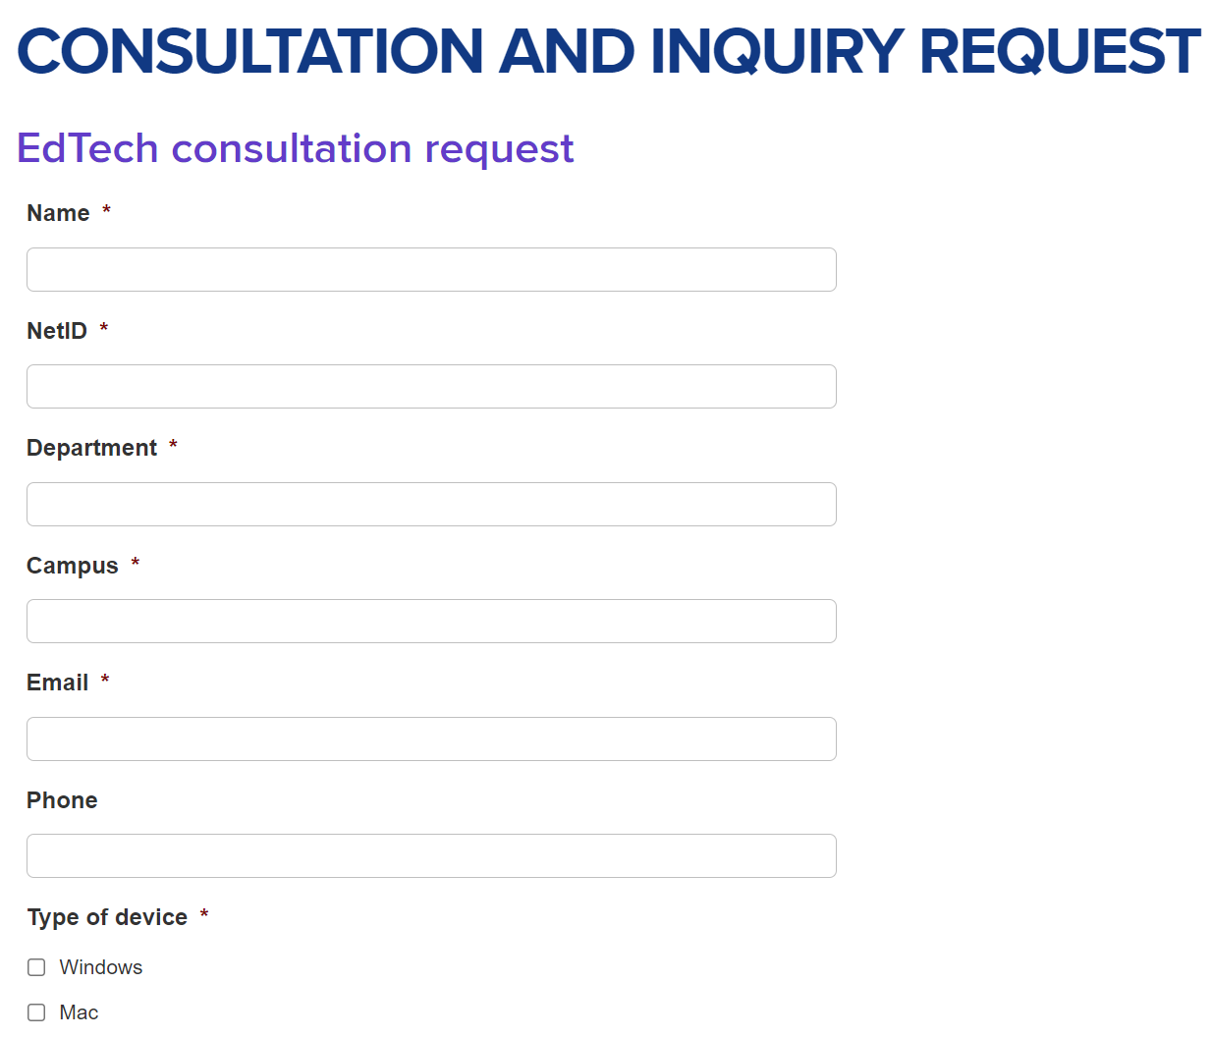
Huskyct support
Training workshops - FINS (uconn.edu)
Training videos - Training videos | Educational Technologies (uconn.edu)
Consultation and Inquiry Request - Consultation and inquiry request | Educational Technologies (uconn.edu)

Slide 24
Additional Resources
See UConn.fins.edu for CETL trainings
See facultystaff.uconn.edu for a variety of resources
SSW Spring trainings and check-in plan for adjuncts (some by course as well – ask the course lead)(Jan, March, and April)

Slide 25
Questions?

