Slide 1
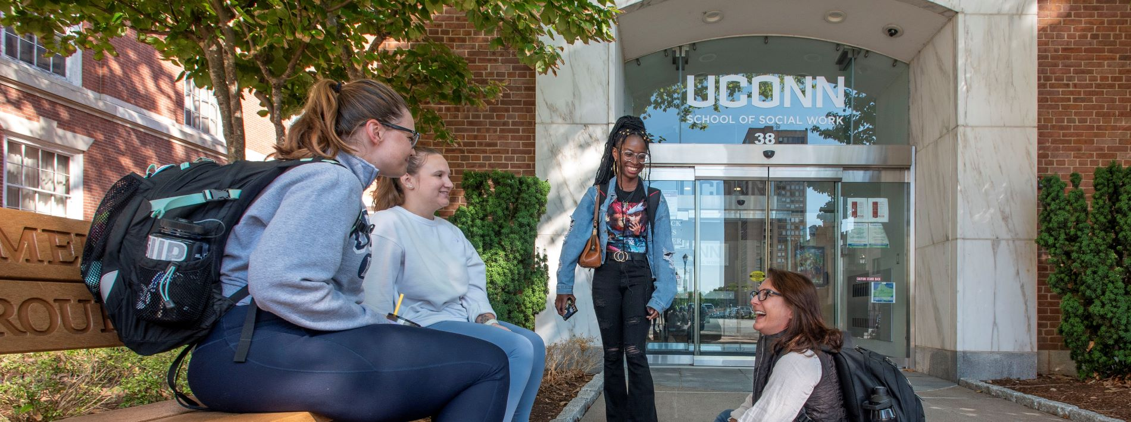
UConn School of Social Work Orientation and Welcome for New Adjunct Instructors Spring 2025

Slide 2
Agenda
Welcome & Introductions UConn SSW’s Commitment to Reflective and Engaged Teaching General Information – Getting Started / Campus Information MSW & BSW Programs – Overview SSW Supports / Key Points of Contact Preparing for the Semester Student Admin & HuskyCT Teaching/Additional Resources
Notes:
Update / moved the order around

Slide 3
Welcome!
Introductions
Rachel Schwartz – MSW Program Director
Chelsea Lebron – Educational Program Assistant
Paula Nieman – BSW Program Director

Slide 4
UConn SSW Mission
Our Mission
Our mission is rooted in a passion for and commitment to social, racial, and economic justice and the improvement of human well-being, both locally and globally. Through our bachelor's, master's, and doctoral degree programs, we strive to prepare the next generation of micro and macro social work practitioners and scholars through excellence in teaching and learning both in the classroom and through innovative field and research experiences. Our faculty is committed to the generation and wide dissemination of cutting edge and impactful knowledge, informed by social justice and anti-oppressive lenses, through traditional and innovative research methodologies.

Slide 5
UConn SSW’s Commitment to Student-Centered Teaching and Learning
The School of Social Work is an inclusive, equitable community that provides life transformative learning opportunities, ensuring access and success for all students. Our curriculum prepares BSW, MSW and PhD students to contribute to the social work profession at micro, mezzo, and macro levels, fostering a lifelong commitment to anti-oppression and social justice. Goal 1: Prepare BSW, MSW, and PhD students for anti-oppressive practice at macro, mezzo, and micro levels, grounded in the values and ethics of the profession. Goal 2: Ensure access to underrepresented groups and others by increasing flexibility of SSW course offerings, field offerings and guidelines, and degree options. Goal 3: Support the learning of all students in our programs, including students from underrepresented groups, ensuring that students have the access, resources, and supports to take full advantage of their educational experience (including coursework, field, and extracurricular activities).
Notes:
From the Strategic Plan
Commitment to teaching, recognizing changing demographics of students, impact of the pandemic, first generation students, diversity of student population, online students/desire for online, differences between BSW/MSW, students managing many responsibilities and roles, many working full-time, may be working in the field already, doing MSW to provide more opportunities within existing workplaces, etc.

Slide 6
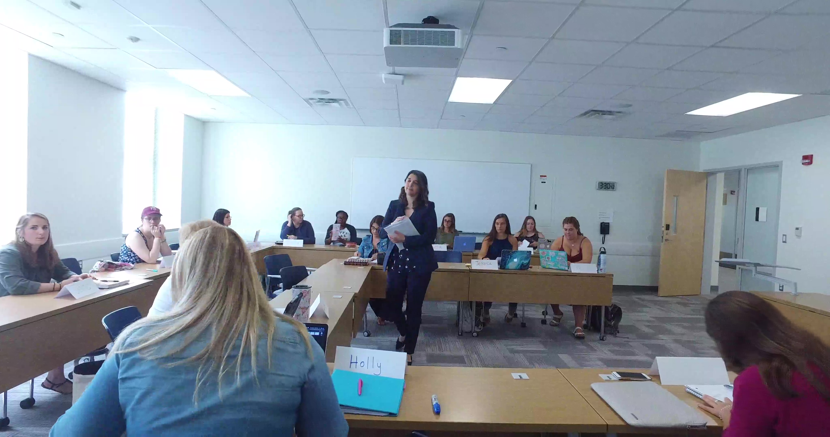
General Information – Getting Started

Slide 7
Getting Set Up
Campus Information
Mailboxes – 1st floor of SSW in Room 103 – Entry Code 2018 Adjunct Office – SSW Room 217 Parking CT Science Center (permit), Convention Center (permit), or Street Parking (metered) Hartford Times Building (10 Prospect) UConn Library at Hartford Public Library ID (Husky One Card) – HTB Room 106 (Student Services) 959-200-3743 Mon – Fri: 8:30am – 4:30pm or by appointment Request online & have it mailed to you

Slide 8
Getting Set Up – Form I-9
Form I-9: Employment Eligibility Verification
All new adjuncts will need to complete an I-9 form. Please contact Iris Strong (Iris.Strong@uconn.edu) to complete your I-9 if you have not already done so. The I-9 is required and used to confirm employment eligibility in the U.S. It can be found at https://www.uscis.gov/i-9 Page 1 must be completed by your start date.

Slide 9
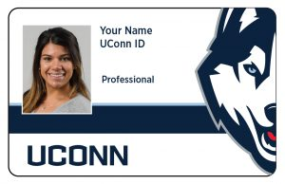
Getting Set Up - Continued
Technology/ Systems
NetID vs. PeopleSoft Your NetID is the primary login for university services, including library access, HuskyCT access, and email access. Your NetID can be found at: https://netid.uconn.edu/ and must be activated with a new password for use. UConn PeopleSoft ID: Your UConn ID number (often called your PeopleSoft number) is a seven-digit number specifically assigned to you. This number is used in the Student Admin system: https://studentadmin.uconn.edu/ and can be found on your UConn ID card. Please use your UConn email address and check it regularly. Your UConn email can be accessed here: https://email.uconn.edu/

Slide 10
First Paycheck and Direct Deposit
Payroll Information
Paychecks are issued bi-weekly Your paychecks will be mailed to you until you set up direct deposit Payroll Helpdesk: https://payroll.uconn.edu/payroll-help-desk/ | Direct deposit is available in https://ess.uconn.edu/ (Core-CT) after your start date Link to 2025 Payroll Calendar: https://payroll.media.uconn.edu/wp-content/uploads/sites/2008/2024/12/2025-Payroll-Calendar.pdf

Slide 11
MSW and BSW Programs
Notes:
Update / moved the order around

Slide 12
Master of Social Work (MSW) Program
On Campus: | 100% Online
Students have opportunity to take some online courses as well) 2-year, 3-year and 4-year options; Advanced Standing Concentrations include: Individuals, Groups and Families; Policy Practice and Community Organizing Specialized programs – Connecticut ¡Adelante!, Scholars in Aging, School Social Work, DCF Cohort Program | Started Fall 2024 3-year/PT program with students taking 1 synchronous online and 1 asynchronous online course each semester; do not start practicum until Year 2 Individuals, Groups and Families concentration
MSW Student Handbook - https://socialwork.uconn.edu/msw-students/
Notes:
MSW program – discuss different program formats and options, specializations; student populations you may have in your courses

Slide 13
Bachelor of Social Work (BSW)
BSW Program
Prepares students for entry-level generalist practice AND for advanced standing MSW study In-person, cohort model (25 students/class) completed in students’ junior and senior undergraduate years Curriculum is similar to MSW foundation year, and includes 406 hour practicum BSW Student Handbook - https://socialwork.uconn.edu/bsw-students-2/
Notes:
Paula – add to slide

Slide 14
Who’s Who
Who’s Who & Key Offices at SSW | Student Supports
Social Work Faculty and Staff - https://socialwork.uconn.edu/our-faculty-and-staff/ Practicum Education – https://socialwork.uconn.edu/bachelors-social-work/bsw-field-education/ UConn Hartford ITS: https://hits.hartford.uconn.edu/ (located in the School of Social Work Building, Lower Level | Room G02) | Office of Student Academic Services (OSAS): https://socialwork.uconn.edu/current-students/ Center for Students with Disabilities - https://csd.uconn.edu/ Title IX / Supports for Pregnant and Parenting Students - https://equity.uconn.edu/pregnant-and-parenting-resources/ UConn Hartford Mental Health Resource Center - https://mhrc.hartford.uconn.edu/ The Writing Center at UConn Hartford - https://wcenter.hartford.uconn.edu/

Slide 15
Role of Faculty Advisors
Faculty Advisors -
To find out who a student’s advisor is, contact Chelsea Lebron or the Program Director (Rachel Schwartz for MSW students; Paula Nieman for BSW students) Faculty Advisors Have Two Primary Roles: Academic and Practicum Every matriculated student (both in practicum and not in practicum) is assigned an advisor at the beginning of the school year The Faculty Advisor: oversees the student’s academic and practicum performance for the year Works with students and instructors and possibly administration when there are challenges or difficulties Supports students in their professional development/career/graduate school decision-making

Slide 16
Role of Faculty Advisors – Cont.
When should I contact the Faculty Advisor?
Frequent Absence, Repeated lateness Late Papers or frequent requests for extensions Lack of communication (e.g., no response to emails) and/or other unprofessional behavior Health or mental health concerns and/or disclosure of difficulty related to basic needs (housing, food, etc.) Email the advisor early on when situation arises. If no response or if problems continue, email the appropriate Program Director Educational/Performance Review Committee & Consultations and Reviews

Slide 17
Getting Ready for the Semester
Notes:
Update / moved the order around

Slide 18
Academic Calendar / Important Dates
Spring 2025
https://registrar.uconn.edu/academic-calendar/ Spring 2025 semester classes begin January 21 and end May 2 Monday classes – January 27 – April 28 Tuesday classes – January 21 – April 29 Wednesday classes – January 22 – April 30 Thursday classes – January 23 – May 1 Friday classes – January 24 – May 2 Asynchronous online classes – weekly modules usually run Mon-Sun or Tues-Mon, students will have access on January 21 – May 2 Spring break – week of March 16 (no classes) Final semester grades to be posted by May 13 at 4pm Add/drop - last day to add is February 3; last day to Withdraw is April 14
Notes:
Is this same for MSW and BSW?
Monday classes – check dates, how many sessions?

Slide 19
Preparing for the Start of Classes
Semester Prep
Review emails and information sent from Chelsea Lebron and also from your course lead Requesting your desk copy of required textbook Updating / personalizing your syllabus Contact info, office hours, updating boilerplate language Adding in due dates, class schedule Course policies – expectations for participation, late work policies Requesting / setting up your HuskyCT course site Integrating WebEx for online courses Adding assignment due dates, opening modules, gradebook Attending trainings to become familiar with course technology Send a welcome email to your students
Notes:
Welcome email – a few days prior, can include syllabus or reference to course site and when it will open, share any information they might need to know for day 1; for in-person, Synch OL remind of class time, share the webex link with students

Slide 20
The Council on Social Work Education (CSWE) Assessment
Educational Policy and Accreditation Standards – 2015 Competencies:
Competency 1: Demonstrate Ethical and Professional Behavior Competency 2: Engage Diversity and Difference in Practice Competency 3: Advance Human Rights and Social, Economic, and Environmental Justice Competency 4: Engage In Practice-informed Research and Research-informed Practice Competency 5: Engage in Policy Practice Competency 6: Engage with Individuals, Families, Groups, Organizations, and Communities Competency 7: Assess Individuals, Families, Groups, Organizations, and Communities Competency 8: Intervene with Individuals, Families, Groups, Organizations, and Communities Competency 9: Evaluate Practice with Individuals, Families, Groups, Organizations, and Communities
Notes:
All courses (except electives) are assessed for a number of CSWE competencies – this should be noted in your syllabus, but if not, you will be provided with further information. There will be specific assignments that are assessed for specific competencies. You will grade your assignments as you normally would, but will also be asked to completed an Assessment/EPAS sheet at the end of the semester where you will provide a score (on a scale from 1-5) about student competency (not meeting, meeting, exceeding) expectations, based on the specific assignment. We will hold a session closer to the end of the semester about this, but please reach out with any questions.
Build out resources in HuskyCT on this?

Slide 21
(CSWE) Assessment Continued
CSWE EPAS Sheets
All instructors are required to participate in the CSWE Assessment process, this is an important part of our accreditation process If you are teaching a non-elective course, you are required to complete an EPAS sheet at the end of the semester. Instructions will be provided – please monitor your UConn email address throughout the semester. These sheets will be sent out by Chelsea Lebron a week or so before final grades are due.

Slide 22
Brief Student Admin & HuskyCT Overview

Slide 23
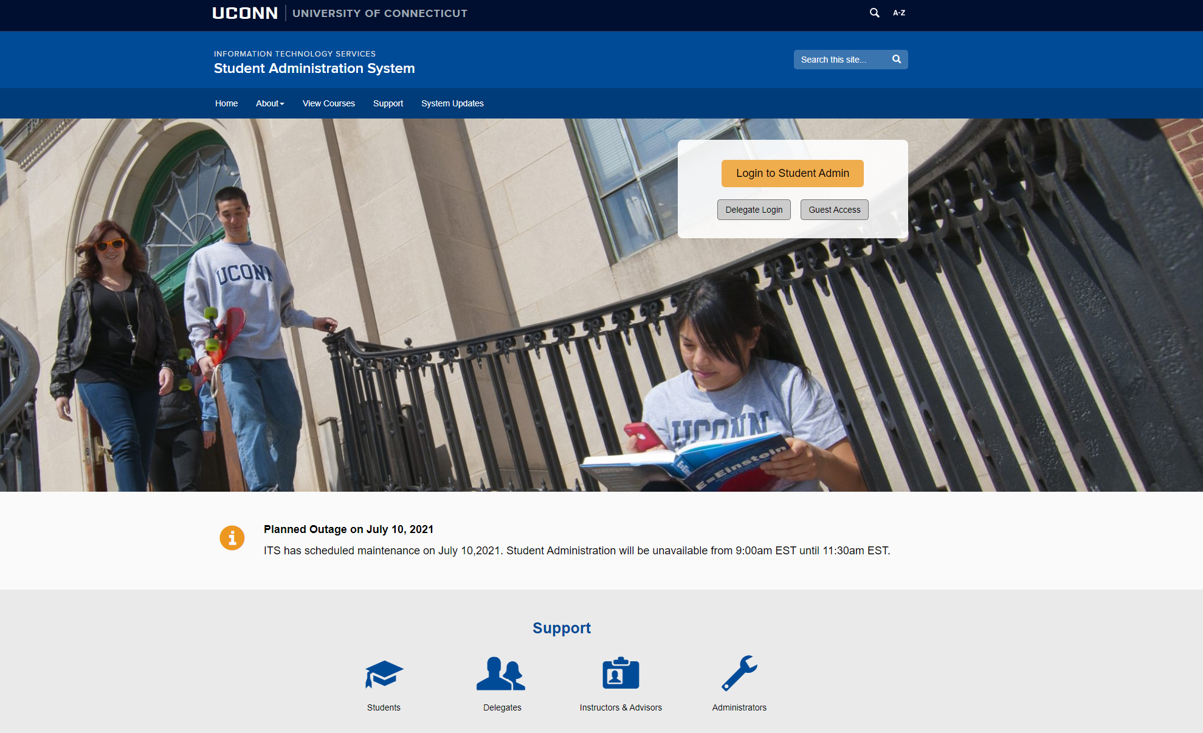
Student Administration System
StudentAdmin
The PeopleSoft Student Administration (Student Admin) system is a collection of interactive course and enrollment information and tools, which students will use starting with the admissions stage and continuing through graduation. A main feature of the system is the online registration tool, which enables students and their advisors to plan and enroll in classes.
Instructors and Advisors Support

Slide 24
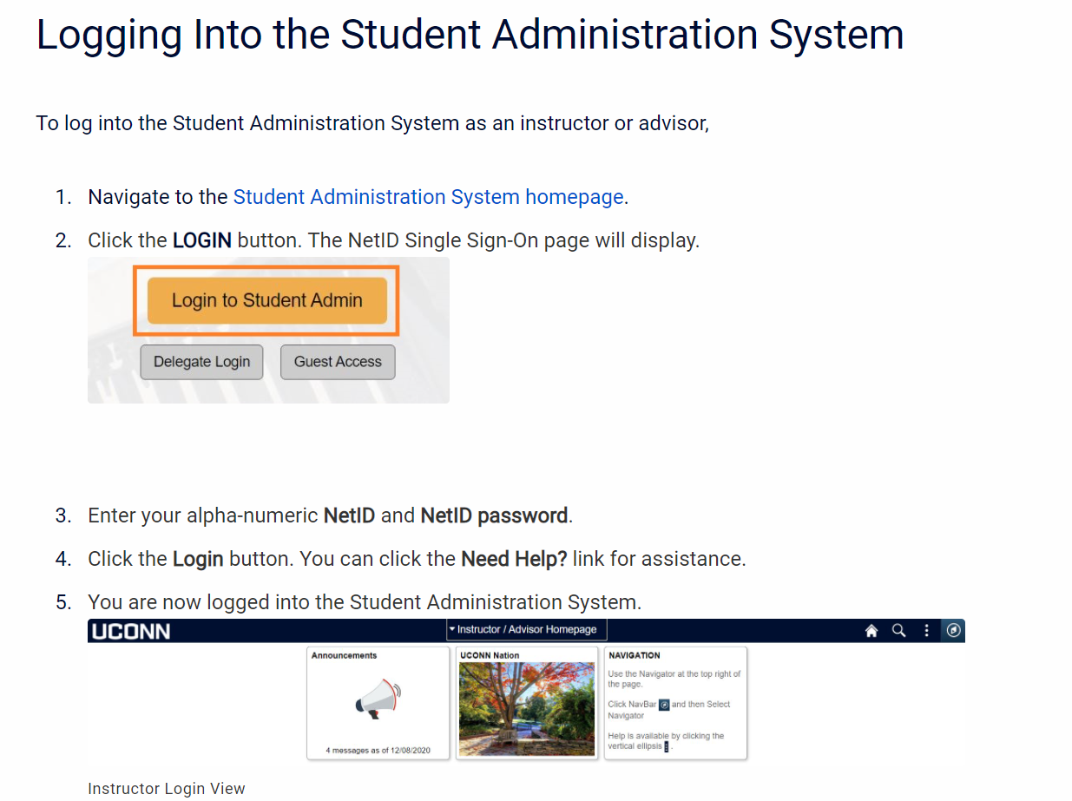
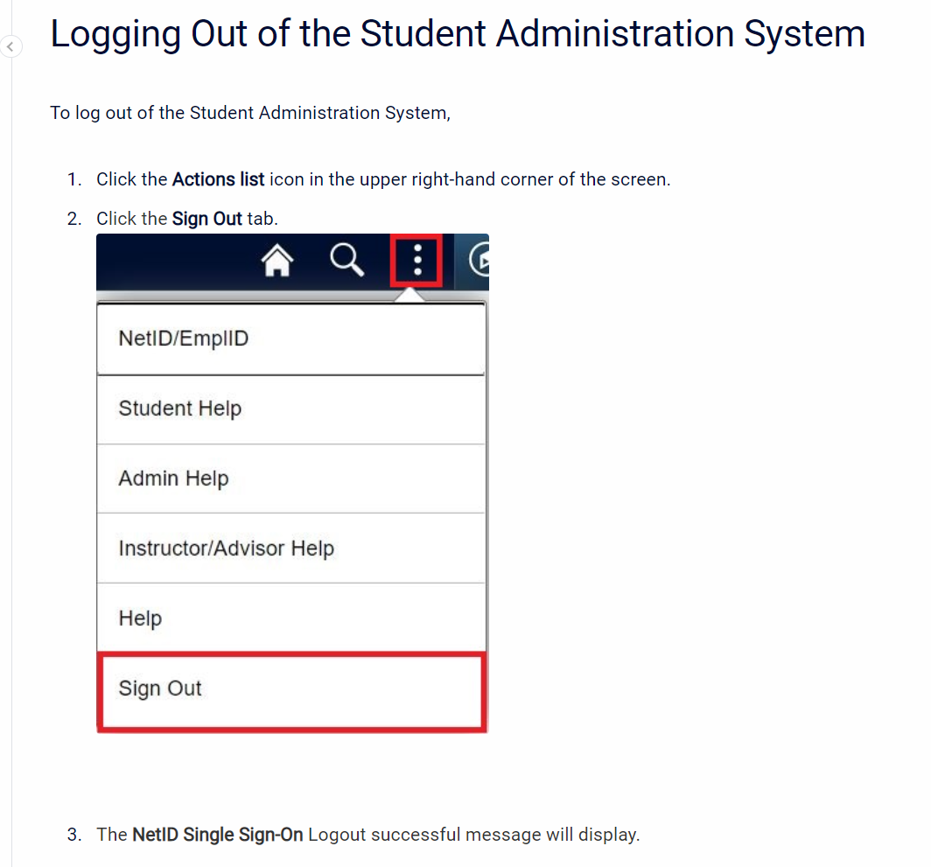
Logging Into & Out of Student Admin
Be sure to save to your favorites
Home | Student Administration System (uconn.edu)

Slide 25
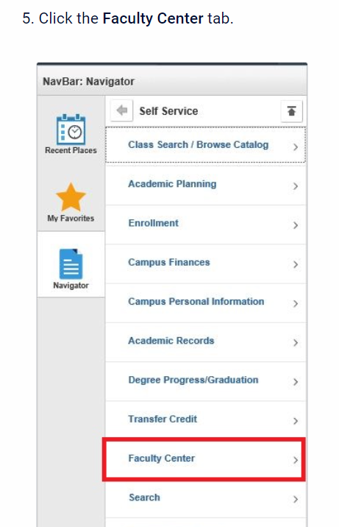
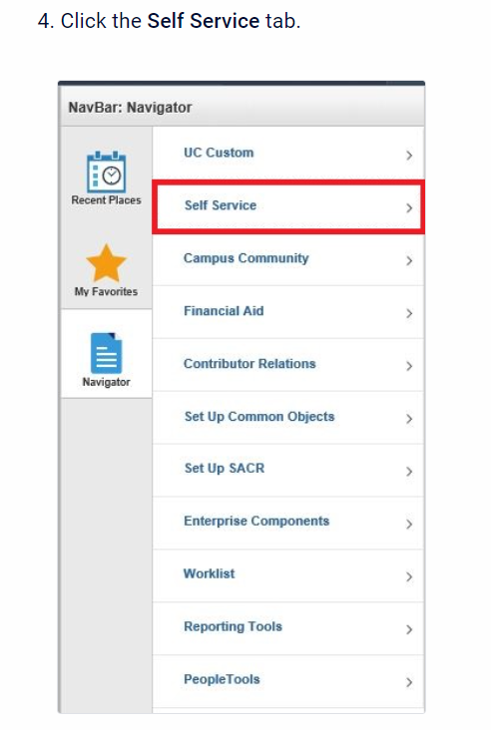
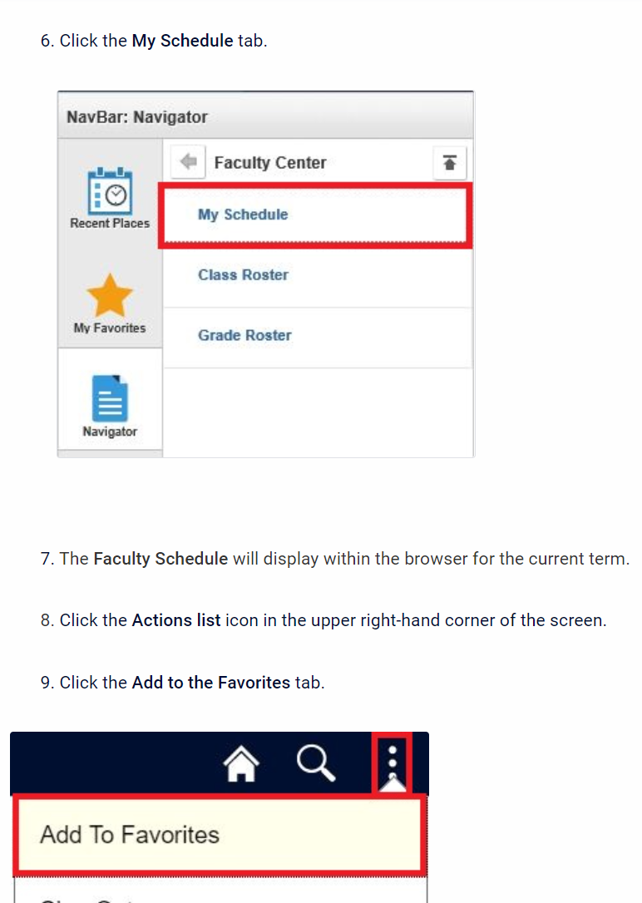
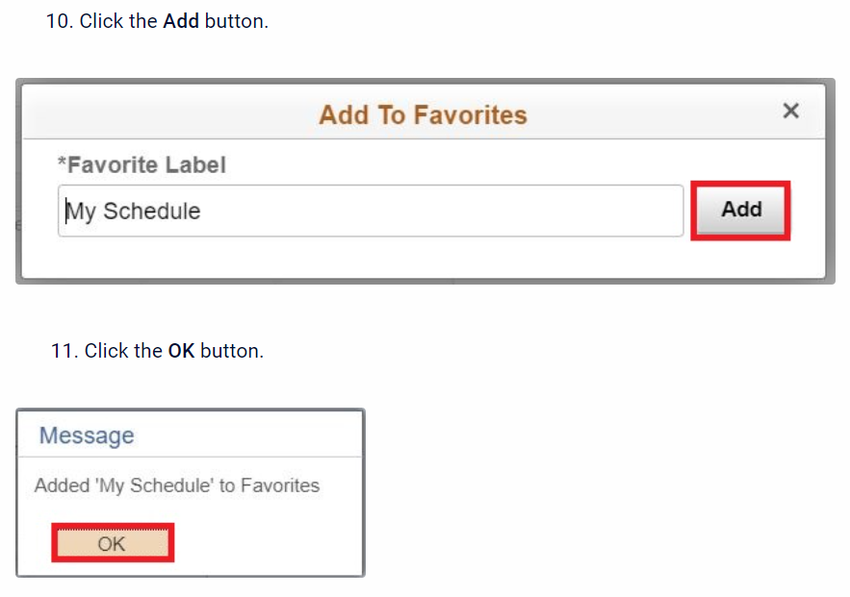
Setting common favorites – my schedule, class roster & Grade roster

Slide 26
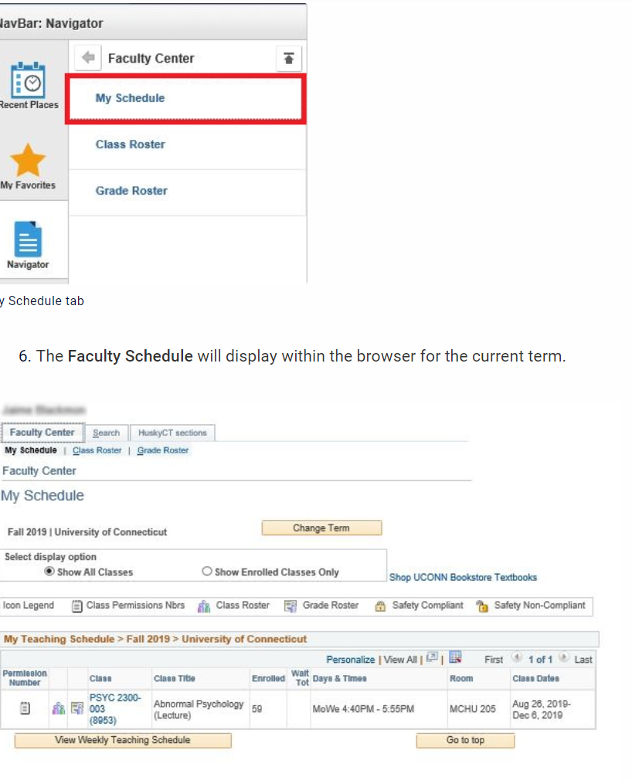
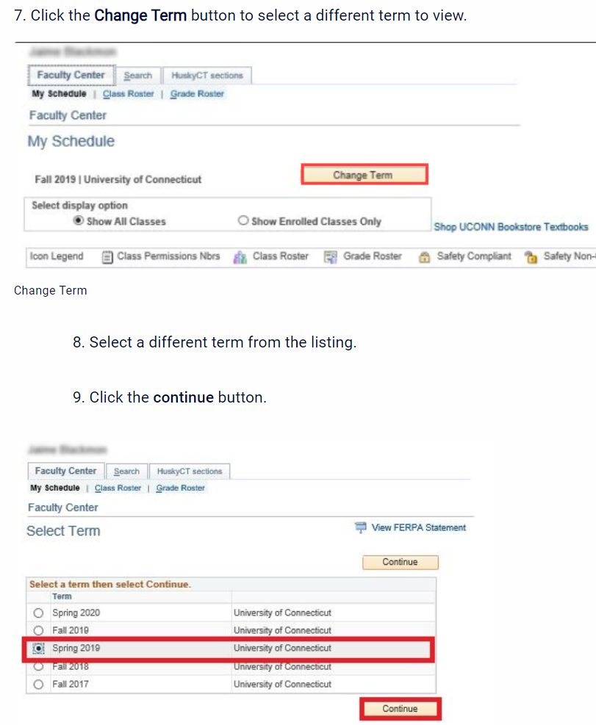
Viewing Class Schedule
Since you will have saved My schedule as a favorite, there will be less steps when you view your schedule.
Please note the highlighted indicates:
Permission number
class
title
# of students enrolled
days & times class meets
room number
semester dates

Slide 27
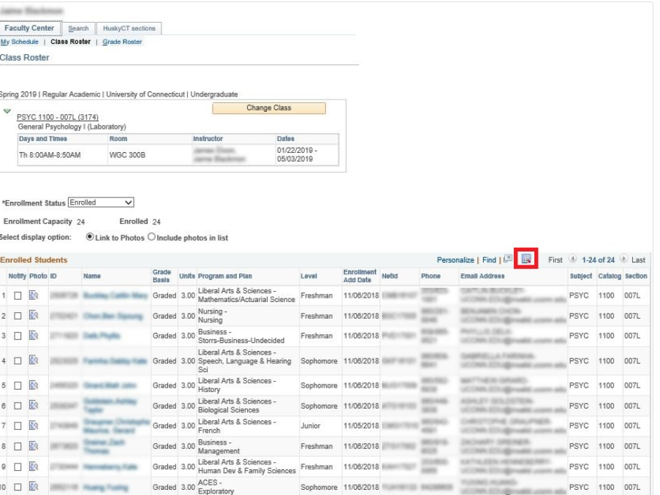
Downloading Class Roster
Log into Student Admin
Go to your Favorites bar and select Class roster
Ensure you are in the correct term
Click the grid icon located to the right of Find (see highlighted).
The roster will download as an Excel document in Chrome.

Slide 28
HuskyCT
HuskyCT is UConn’s name for the Blackboard learning management system used. HuskyCT sites are used for face-to-face classes and fully online classes.
The use of HuskyCT is so widespread that students expect to see a HuskyCT site for each class they are taking and are worried when they don’t.
Most common uses of HuskyCT:
send announcements
post content and
post grades
Instructors also use HuskyCT for
online submission of assignments, discussions, and quizzes.
Blackboard Learn (uconn.edu)

Slide 29
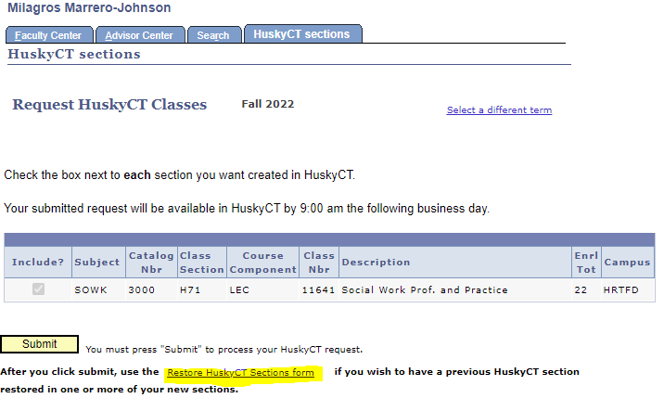
HuskyCT Course Request
HuskyCT
Log into Student Admin Go to My Schedule Click on HuskyCT sections (top right tab) Click on course Hit submit You will be notified by email when your HuskyCT site is available (usually one business day)

Slide 30
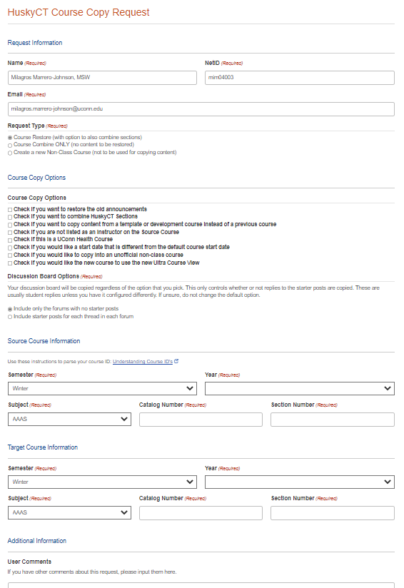
Restore HuskyCT Sections Form
Restore HuskyCT Sections
You will then see this form when you click on Restore HuskyCT Sections Please complete the form thoroughly You will need the source course information if you will request copy content from a template or development course Hit submit at bottom of the form

Slide 31
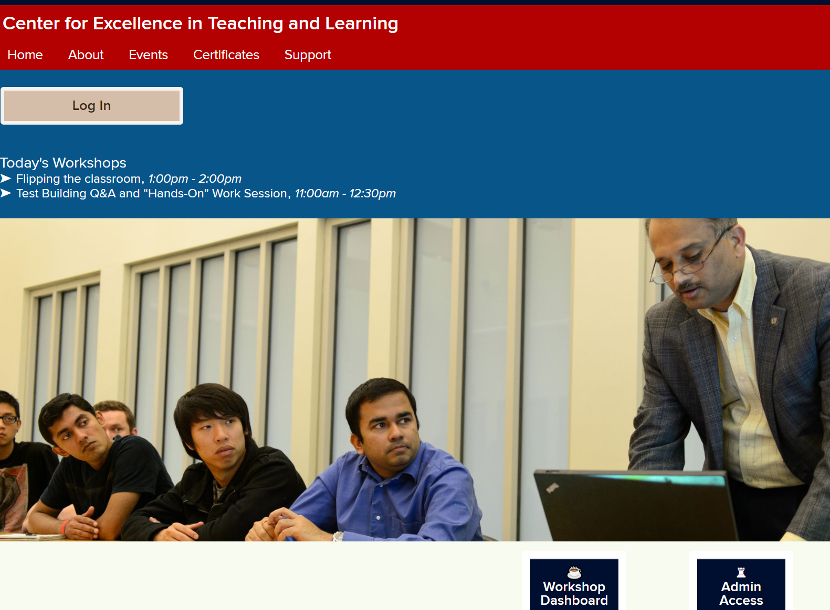
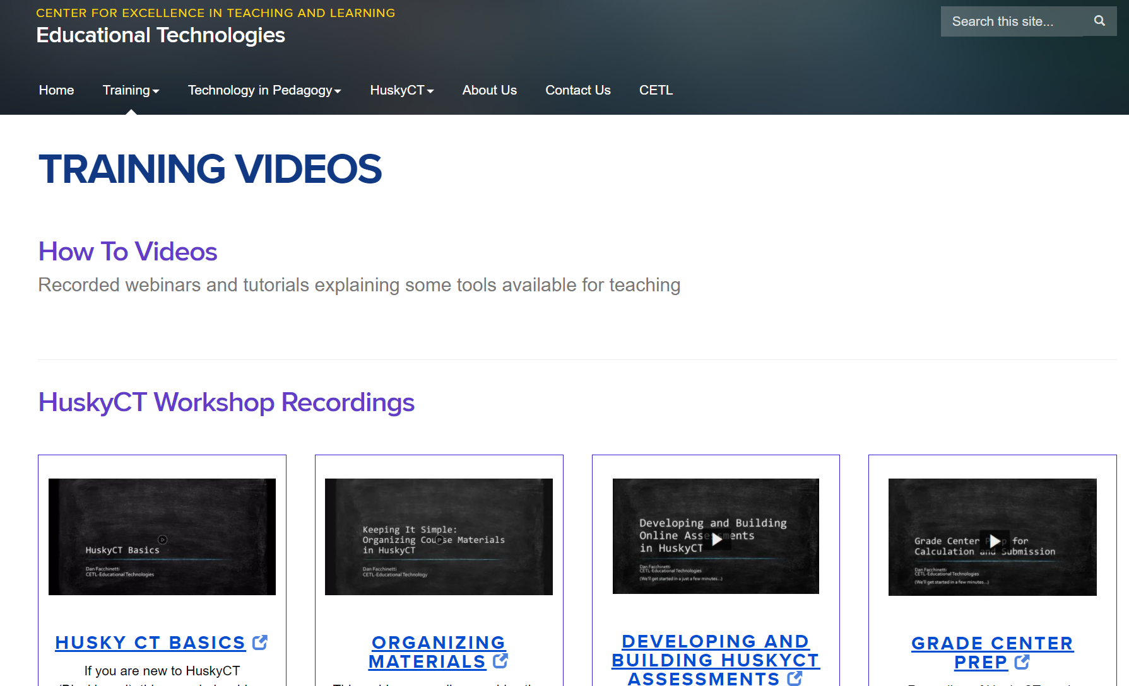
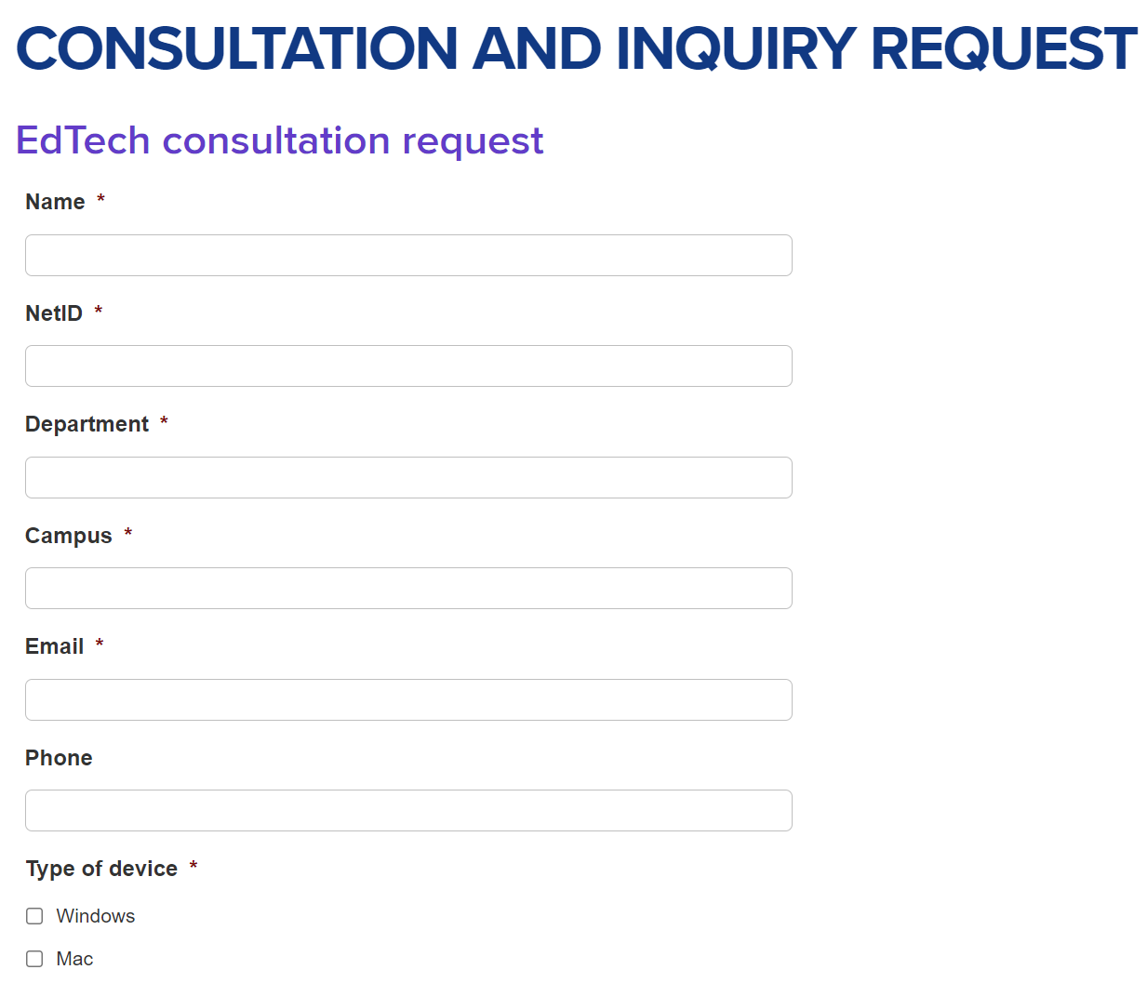
HuskyCT Support
Training workshops - FINS (uconn.edu)
Training videos - Training videos | Educational Technologies (uconn.edu)
Consultation and Inquiry Request - Consultation and inquiry request | Educational Technologies (uconn.edu)

Slide 32
Teaching/Additional Resources
Resources
Pedagogy workshops at SSW Center for Excellence in Teaching and Learning (CETL) - https://cetl.uconn.edu/ Questions about course content/assignments - Course lead / other instructors teaching your course Classroom management – reach out to the relevant program director Adjunct Faculty Webpage: https://socialwork.uconn.edu/info-faculty-staff/ Adjunct Faculty Resource Guide and New Hire Flier (see email from Chelsea!) Adjunct Faculty Resource Center in HuskyCT
Notes:
Facing a challenging discussion in class or feel stuck? For support and consultation, please reach out to the relevant Program Director. Additional potential sources of support and guidance may include your teaching group.
Phare share ideas for workshop topics and feedback to help us build on this initiative.
Please join us for events at the SSW and talk to students about them.

Slide 33
Contact Information
Please reach out with any questions!
Chelsea Lebron, Educational Program Assistant Email: Chelsea.lebron@uconn.edu Phone: 959-200-3649 Paula Nieman, BSW Program Director Email: Paula.nieman@uconn.edu Phone: 959-200-3659 Rachel Schwartz, MSW Program Director Email: Rachel.schwartz@uconn.edu Phone: 959-200-3635; 732-713-0073 (cell)

Slide 34
Questions?

